Slide 1
In-store Pickup using iBeacon chips
SWE 600
Team Members
Nauka Shah, 24083814
Ayesha Taqdees, 90366
Aditi Parikh, 95991
Yunfeiyue Liu, 92636

Slide 2
Problem Statement:
While online shopping is convenient, in-store pickup allows consumers to place an order from online, avoid shipping costs and get their item in minutes without working through the store. But Many times consumers have to queue behind other shoppers when they arrive in-store to pick up the order, before being called over the PA system once their order is ready. With beacons, brands can now use geofencing to keep a customer’s order ready just before they arrive when they opt for in-store pickup.
Works as a smart Reminder if Customer is passing thru the store without picking up the online ordered stuffs and provides an option for him to click and collect.

Slide 3
Features
Application will generate list of orders fetched from the store APIs
User will be notified if he is in range of the store.
User will be notified if an order is in process.
User will be notified when order is ready to pickup.
Application will have option to click and collect.
User will get confirmation of order completion and order details.
User will be able to see Order history.

Slide 4
Requirement Analysis
Every software project requires a requirement analysis. This helps in making sure that the exact proposed system is built.
The purpose of requirement analysis is to identify the requirements that help in building the proposed system.
These requirements are of two kinds:
Functional Requirements
Nonfunctional Requirements.

Slide 5
How System Works?
Users downloads and installs the app.
Users will sign up for an account using an email.
With the access to the API key, developer key will be known to the API provider and further functionalities can be performed
App will fetch open order details of registered email addresses using store’s API based on the API access
Application has to communicate with store API to get order details, and access API functionality
System will scan all the emails with the keywords like “order number” and “pickup to find pickup orders.
System will create entries for the orders with the order id, merchant name, beacon id and order status.
The App using the phone's ibeacon will constantly scan the environment for BLE devices such as beacons. (iBeacon is a new location technology that lets any phone using iOS 7 or newer constantly scan the environment for BLE devices such as beacons).
When a user's phone is in the range of the beacon in the store, the phone will detect the beacon and get the beacon id.
The system will query the database to find if there are any open orders associated with the beacon id.
If there are any open orders, the system will send the notification to the beacon in the store using the phone SDK.

Slide 6
Functional requirements
The Application shall have login and logout functionality.
App shall fetch order details from the store APIs.
App should generate a list of orders.
Users will be able to see the list of open orders in the app.
App should be able to communicate with the beacons in the store if the user is in the range.
App should notify the user if he is in the range of 90 meters from the store where he placed the order(example:You are near the store).
Apps should notify the User if an order is in process.
Users should be able to see the updated status of the order in the app.

Slide 7
9. Application should notify the User if an order is ready for pickup.
10. Application shall have the option to click and collect.
11. Store will get notified if the user is ready to collect the order.
12. Users should be able to see in the app that the order is ready for pick up.
13. The user should get the confirmation of order completion and order details.
14. Users will be able to see the list of completed orders in the app.

Slide 8
Non-functional requirements
Response time of the application should be between two and five seconds
System should have strong Authentication (Security)
Service should be up and running all the time (Availability)
System should be scalable (The highest workloads under which the system will still meet the performance requirements) (Scalability)
System has to be reliable which means the system would run without a failure for a given period of time under predefined conditions. (Reliability)

Slide 9
Reliability Requirements
Requirement | Failure
Fetch order details using store APIs | User won’t be able to see orders in our app
Beacon Failure | Beacon listening will fail and user won’t be notified for the order status
Cell Phone switched-off | Human error - beacon communication failure
Database connection loss | System will not create entries for the orders with the order id, merchant name, beacon id and order status

Slide 10
Reliability Metric to be used
ROCOF:
ROCOF measures the frequency of occurrence of unexpected behavior of the software. It basically measures how may times the software product fails. ROCOF measure of a software product can be obtained by having the record of the behavior of a software product. ROCOF is basically the total number of failures occurring during the specified time interval.
Suggested Value - 0.1 - 10 Failures per 100 Time Units.

Slide 11
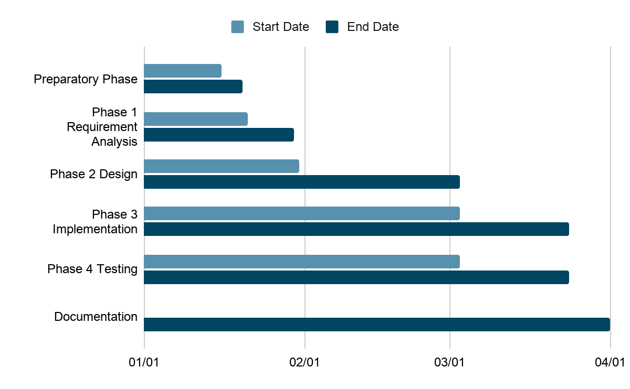
Project Schedule

Slide 12
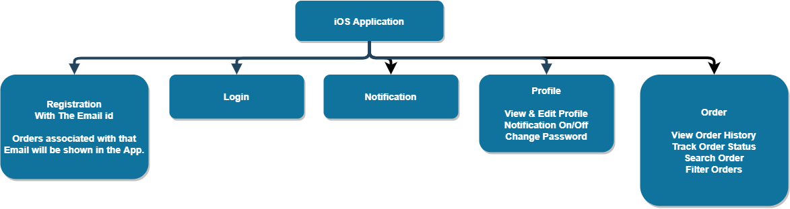
Click And Collect Modules

Slide 13
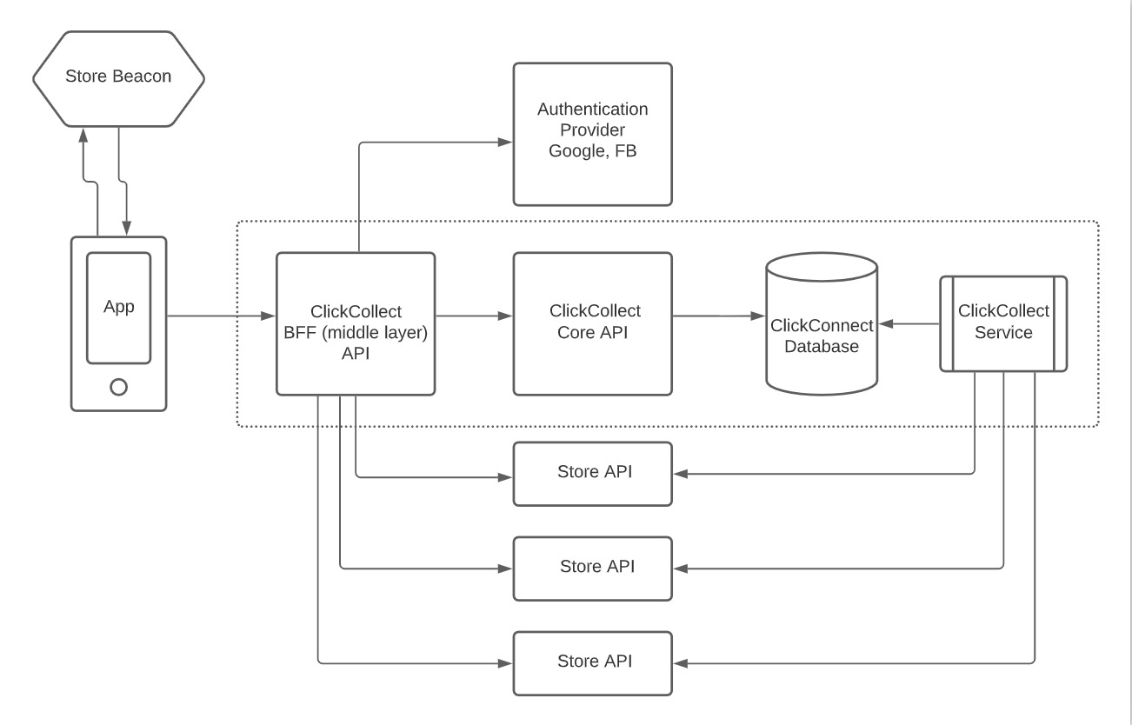
Software Architecture

Slide 14
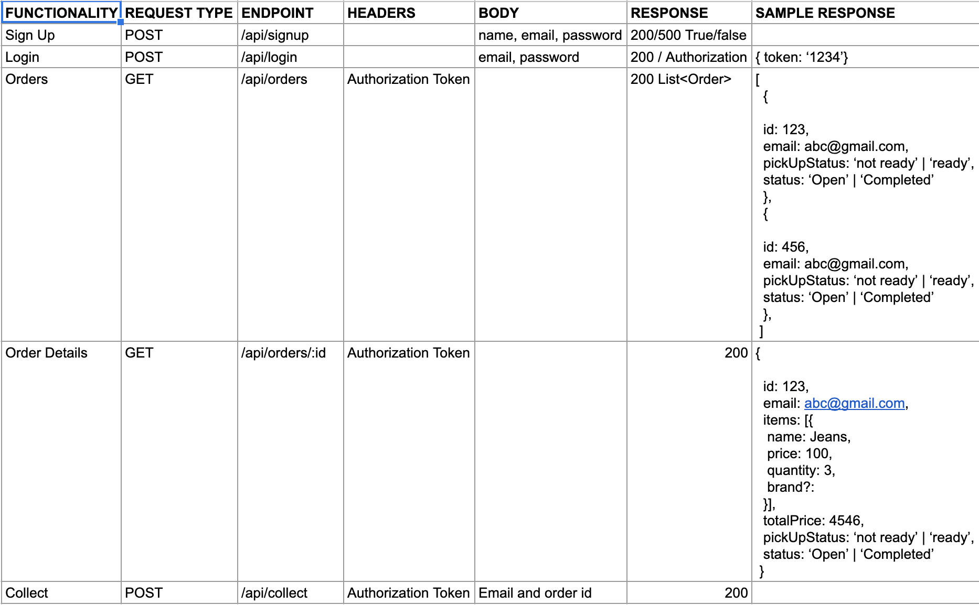
API Endpoints

Slide 15

Security Attributes
Authentication
Authorization
Encryption on the wire: using TLS
Encryption at Rest: using KMS
Server
Username / password
Encryption on the wire (TLS)
HTTPS
Authentication
Authorization
KMS
Application Processor
Exchange data
Encryption on the wire (TLS)
HTTPS
Encryption at rest
Database

Slide 16
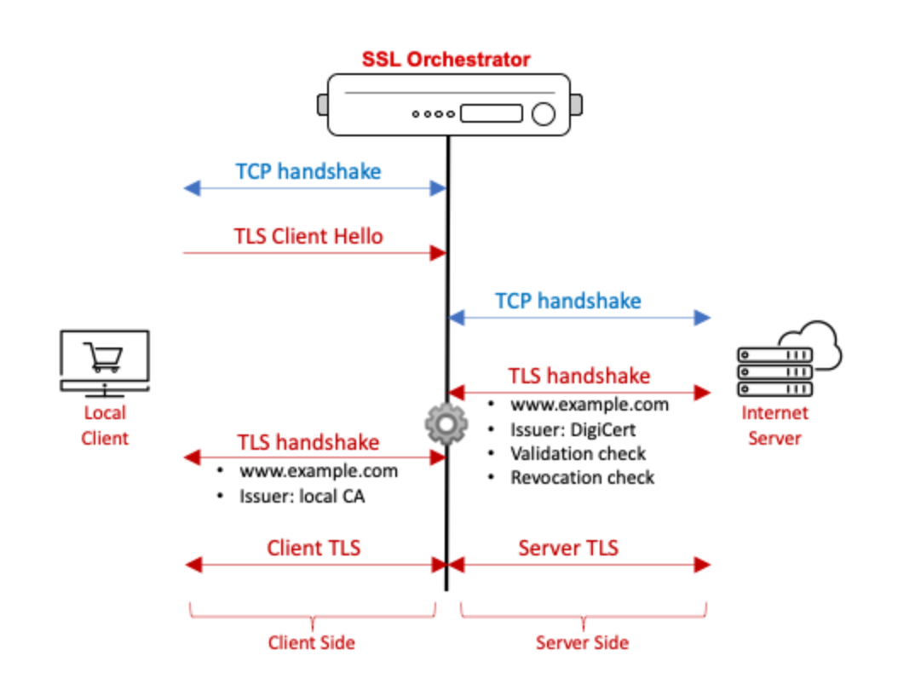
Encryption on the wire
TLS handshake
Client and server exchange certificates and public key
Client data encryption
Client encrypts data with server’s public key
Server data decryption
Server decrypts data with server’s private key
Prevents man-in-the-middle attack

Slide 17
Security Component in Design
Authenticating
users
Providing secure configuration
File input validation
Protecting sensitive data
Handling exceptions
Denial of service
Firewall
Web server
Application
server
Application
Application
Database
Protecting sensitive data
Authorizing users
Coarse input validation
Preventing
Parameter
manipulation

Slide 18
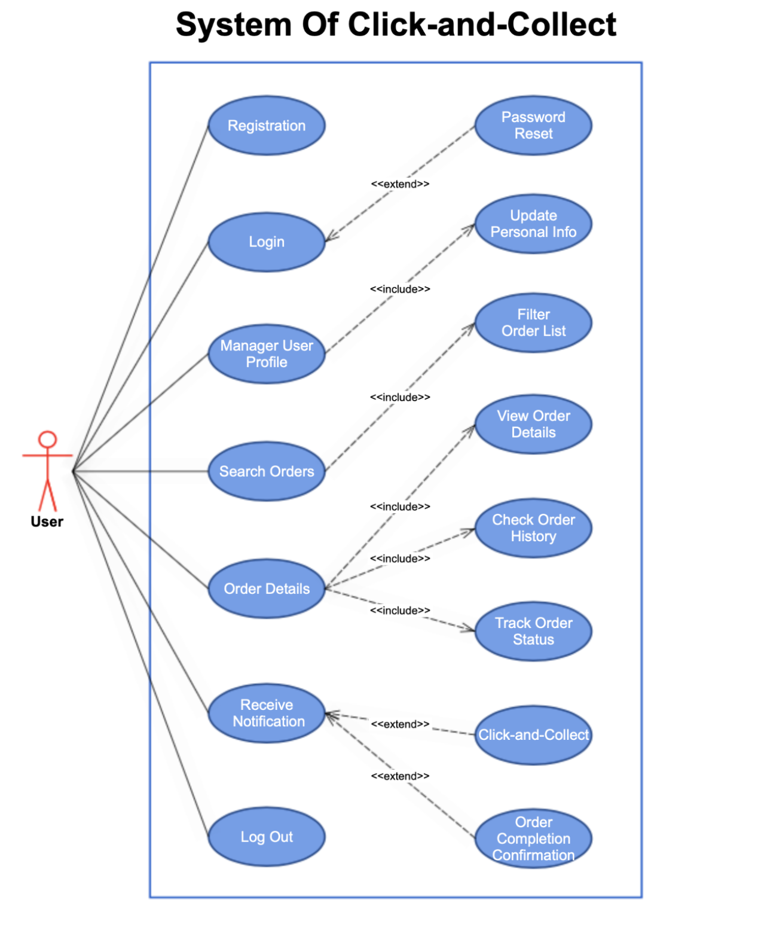
Use Case
Diagram

Slide 19
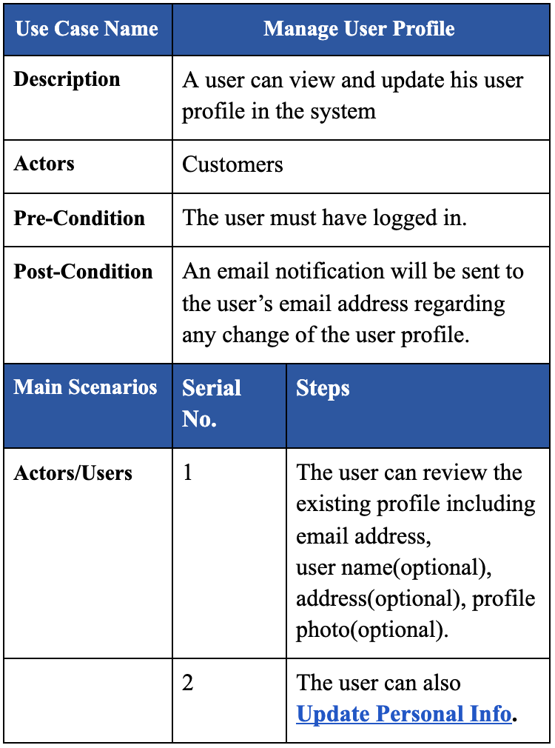
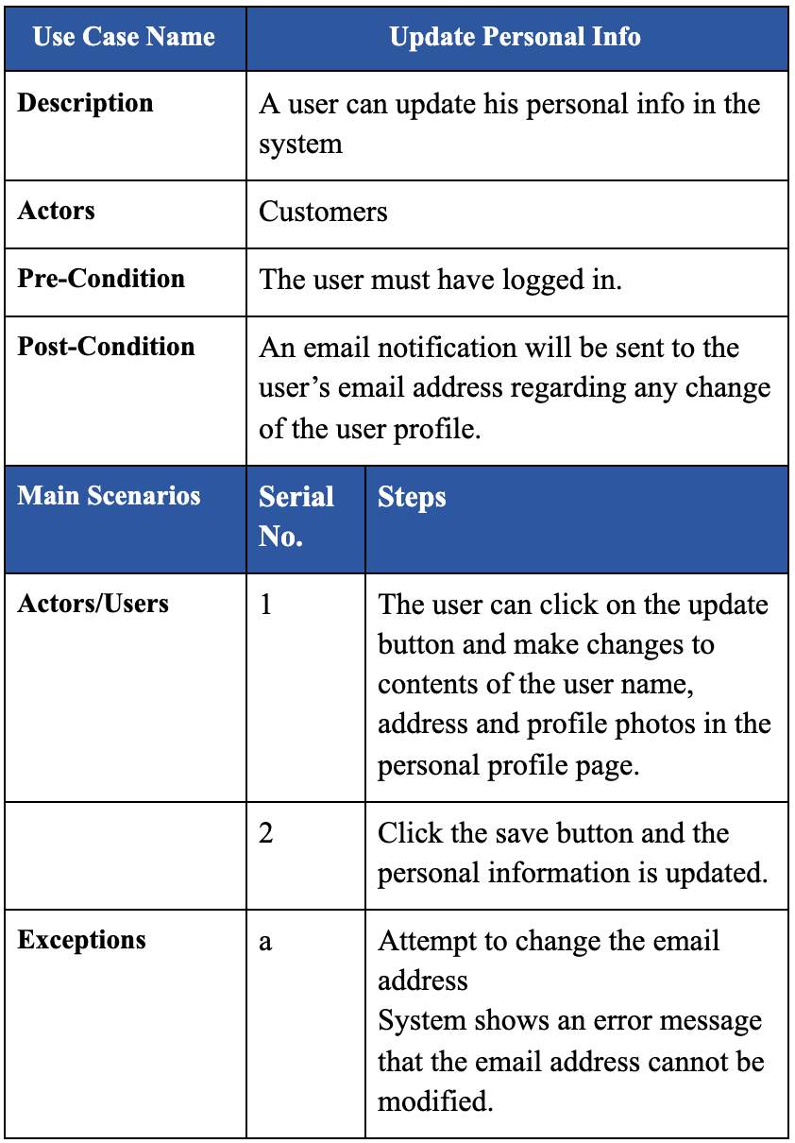
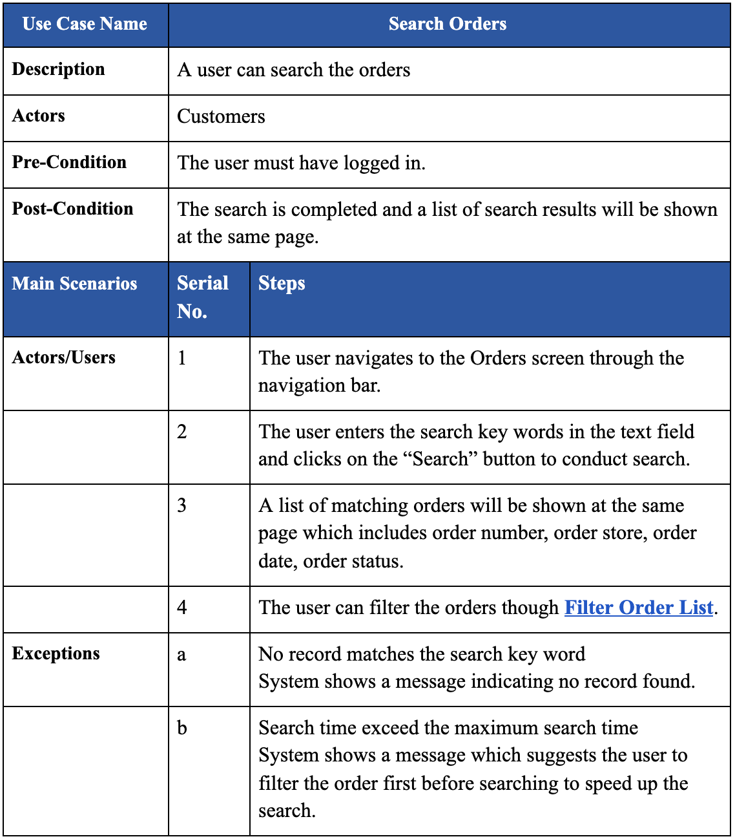
Use Case Schema

Slide 20
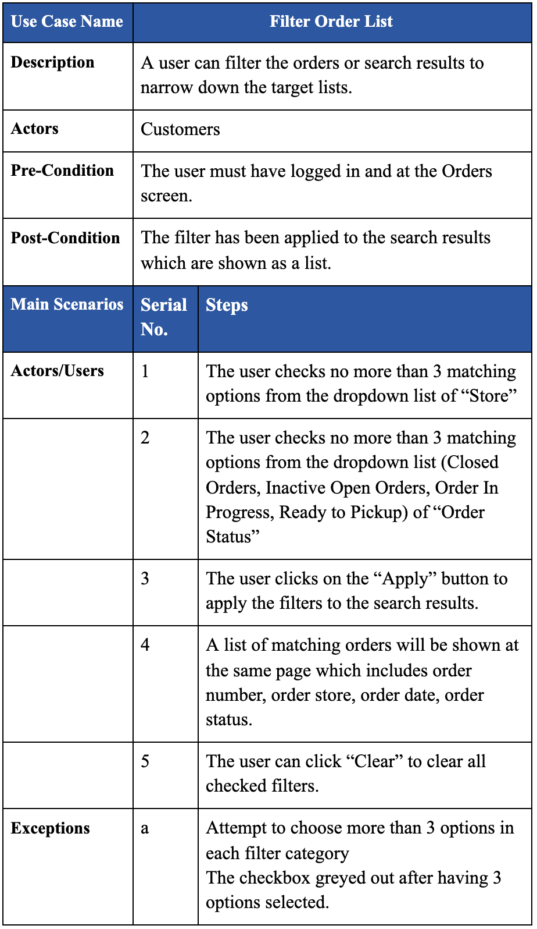
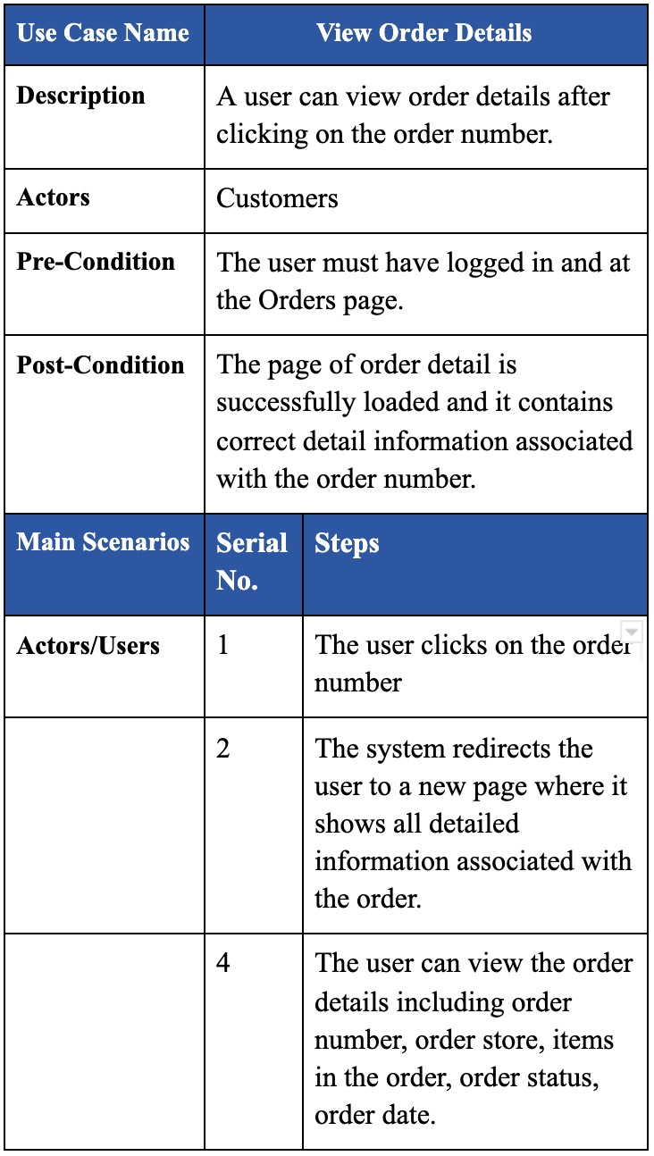
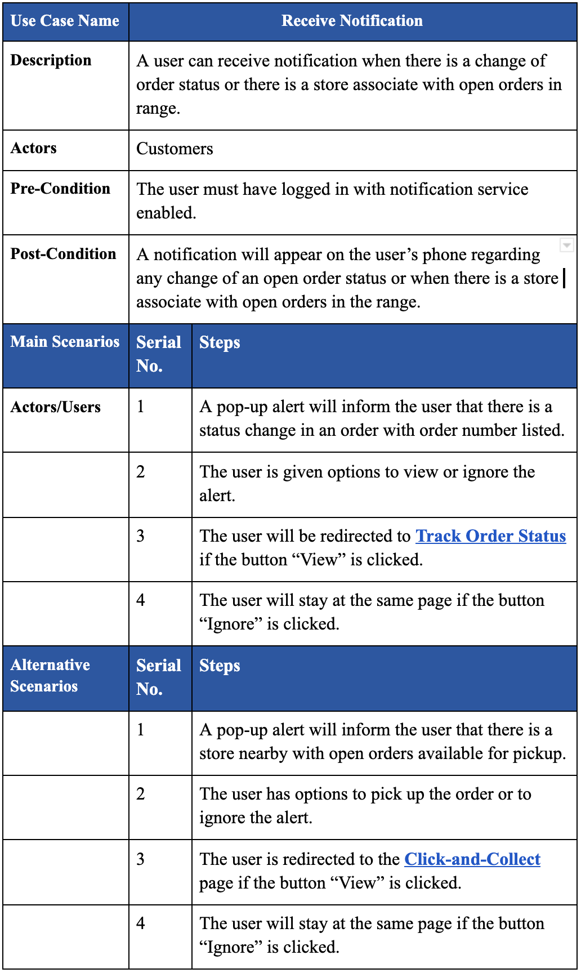
Use Case Schema

Slide 21
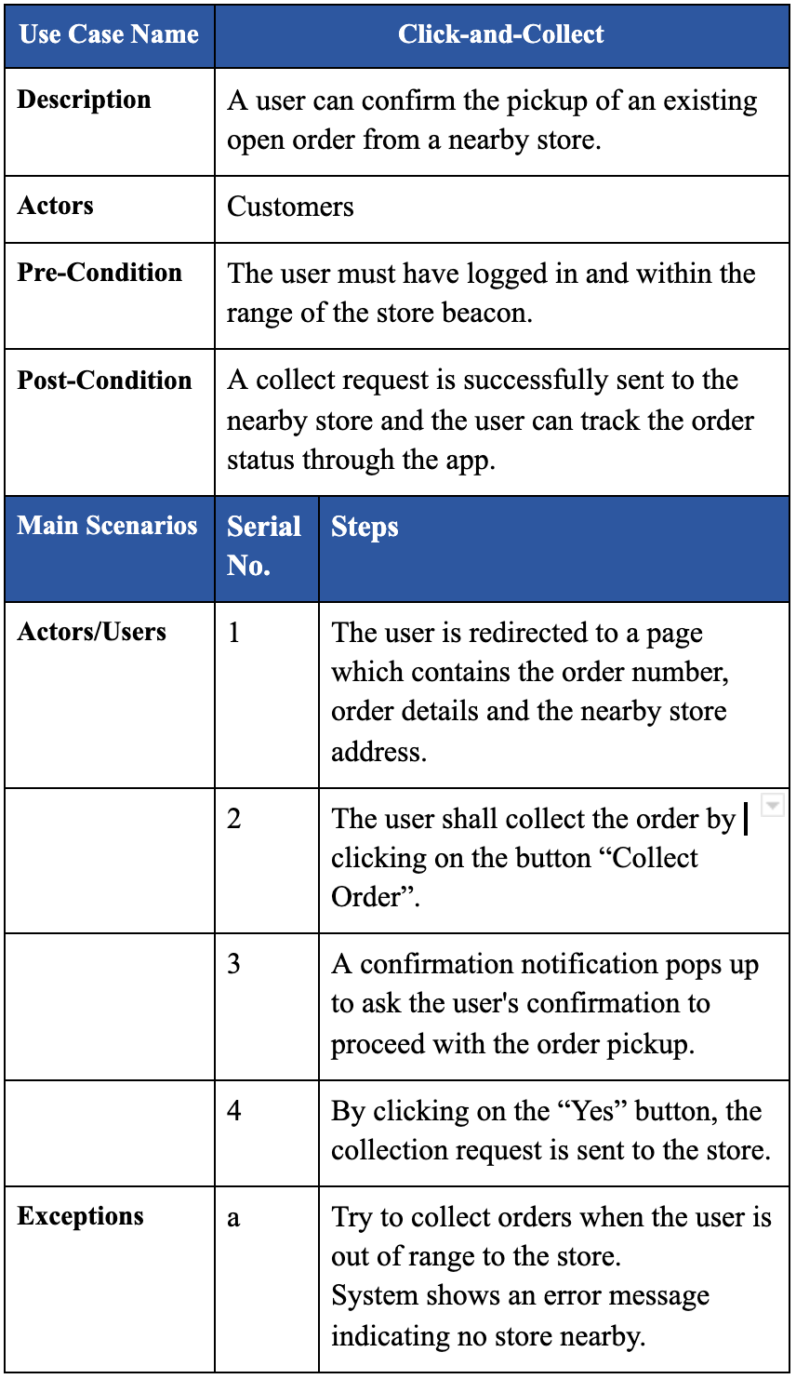
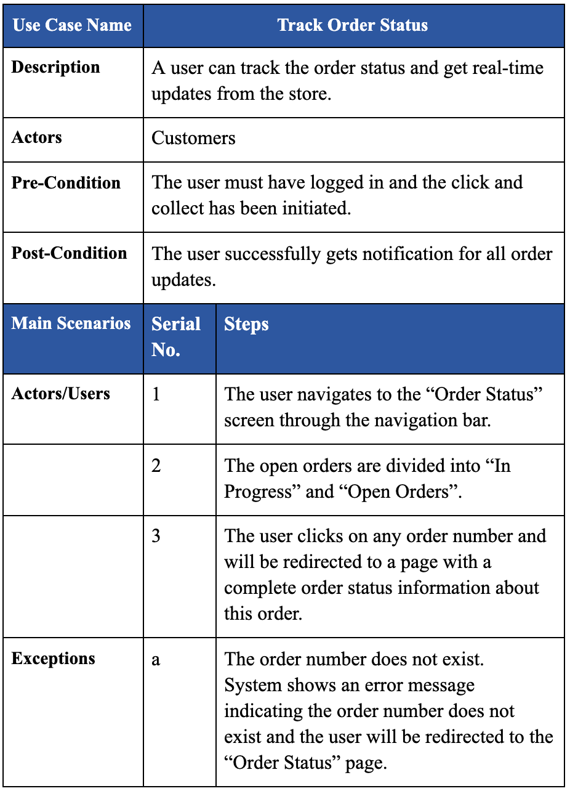
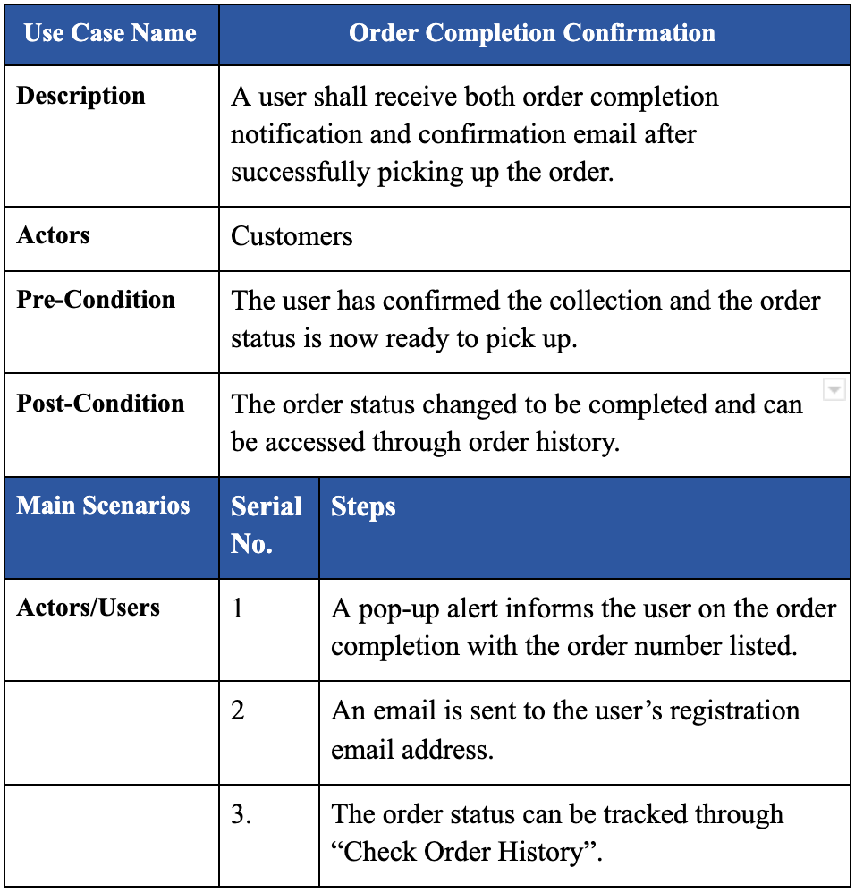
Use Case Schema

Slide 22
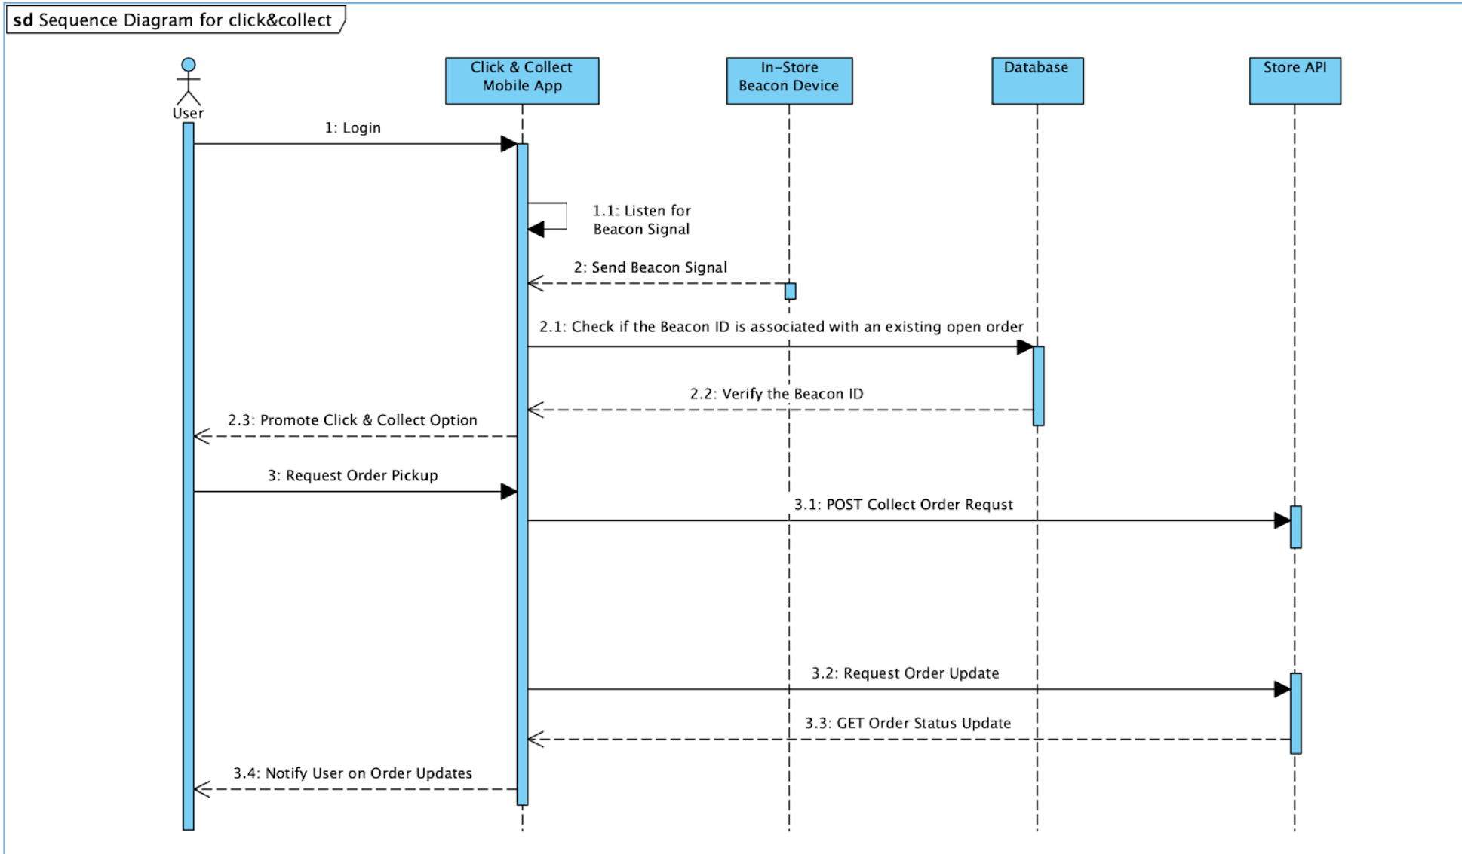
Sequence Diagram

Slide 23
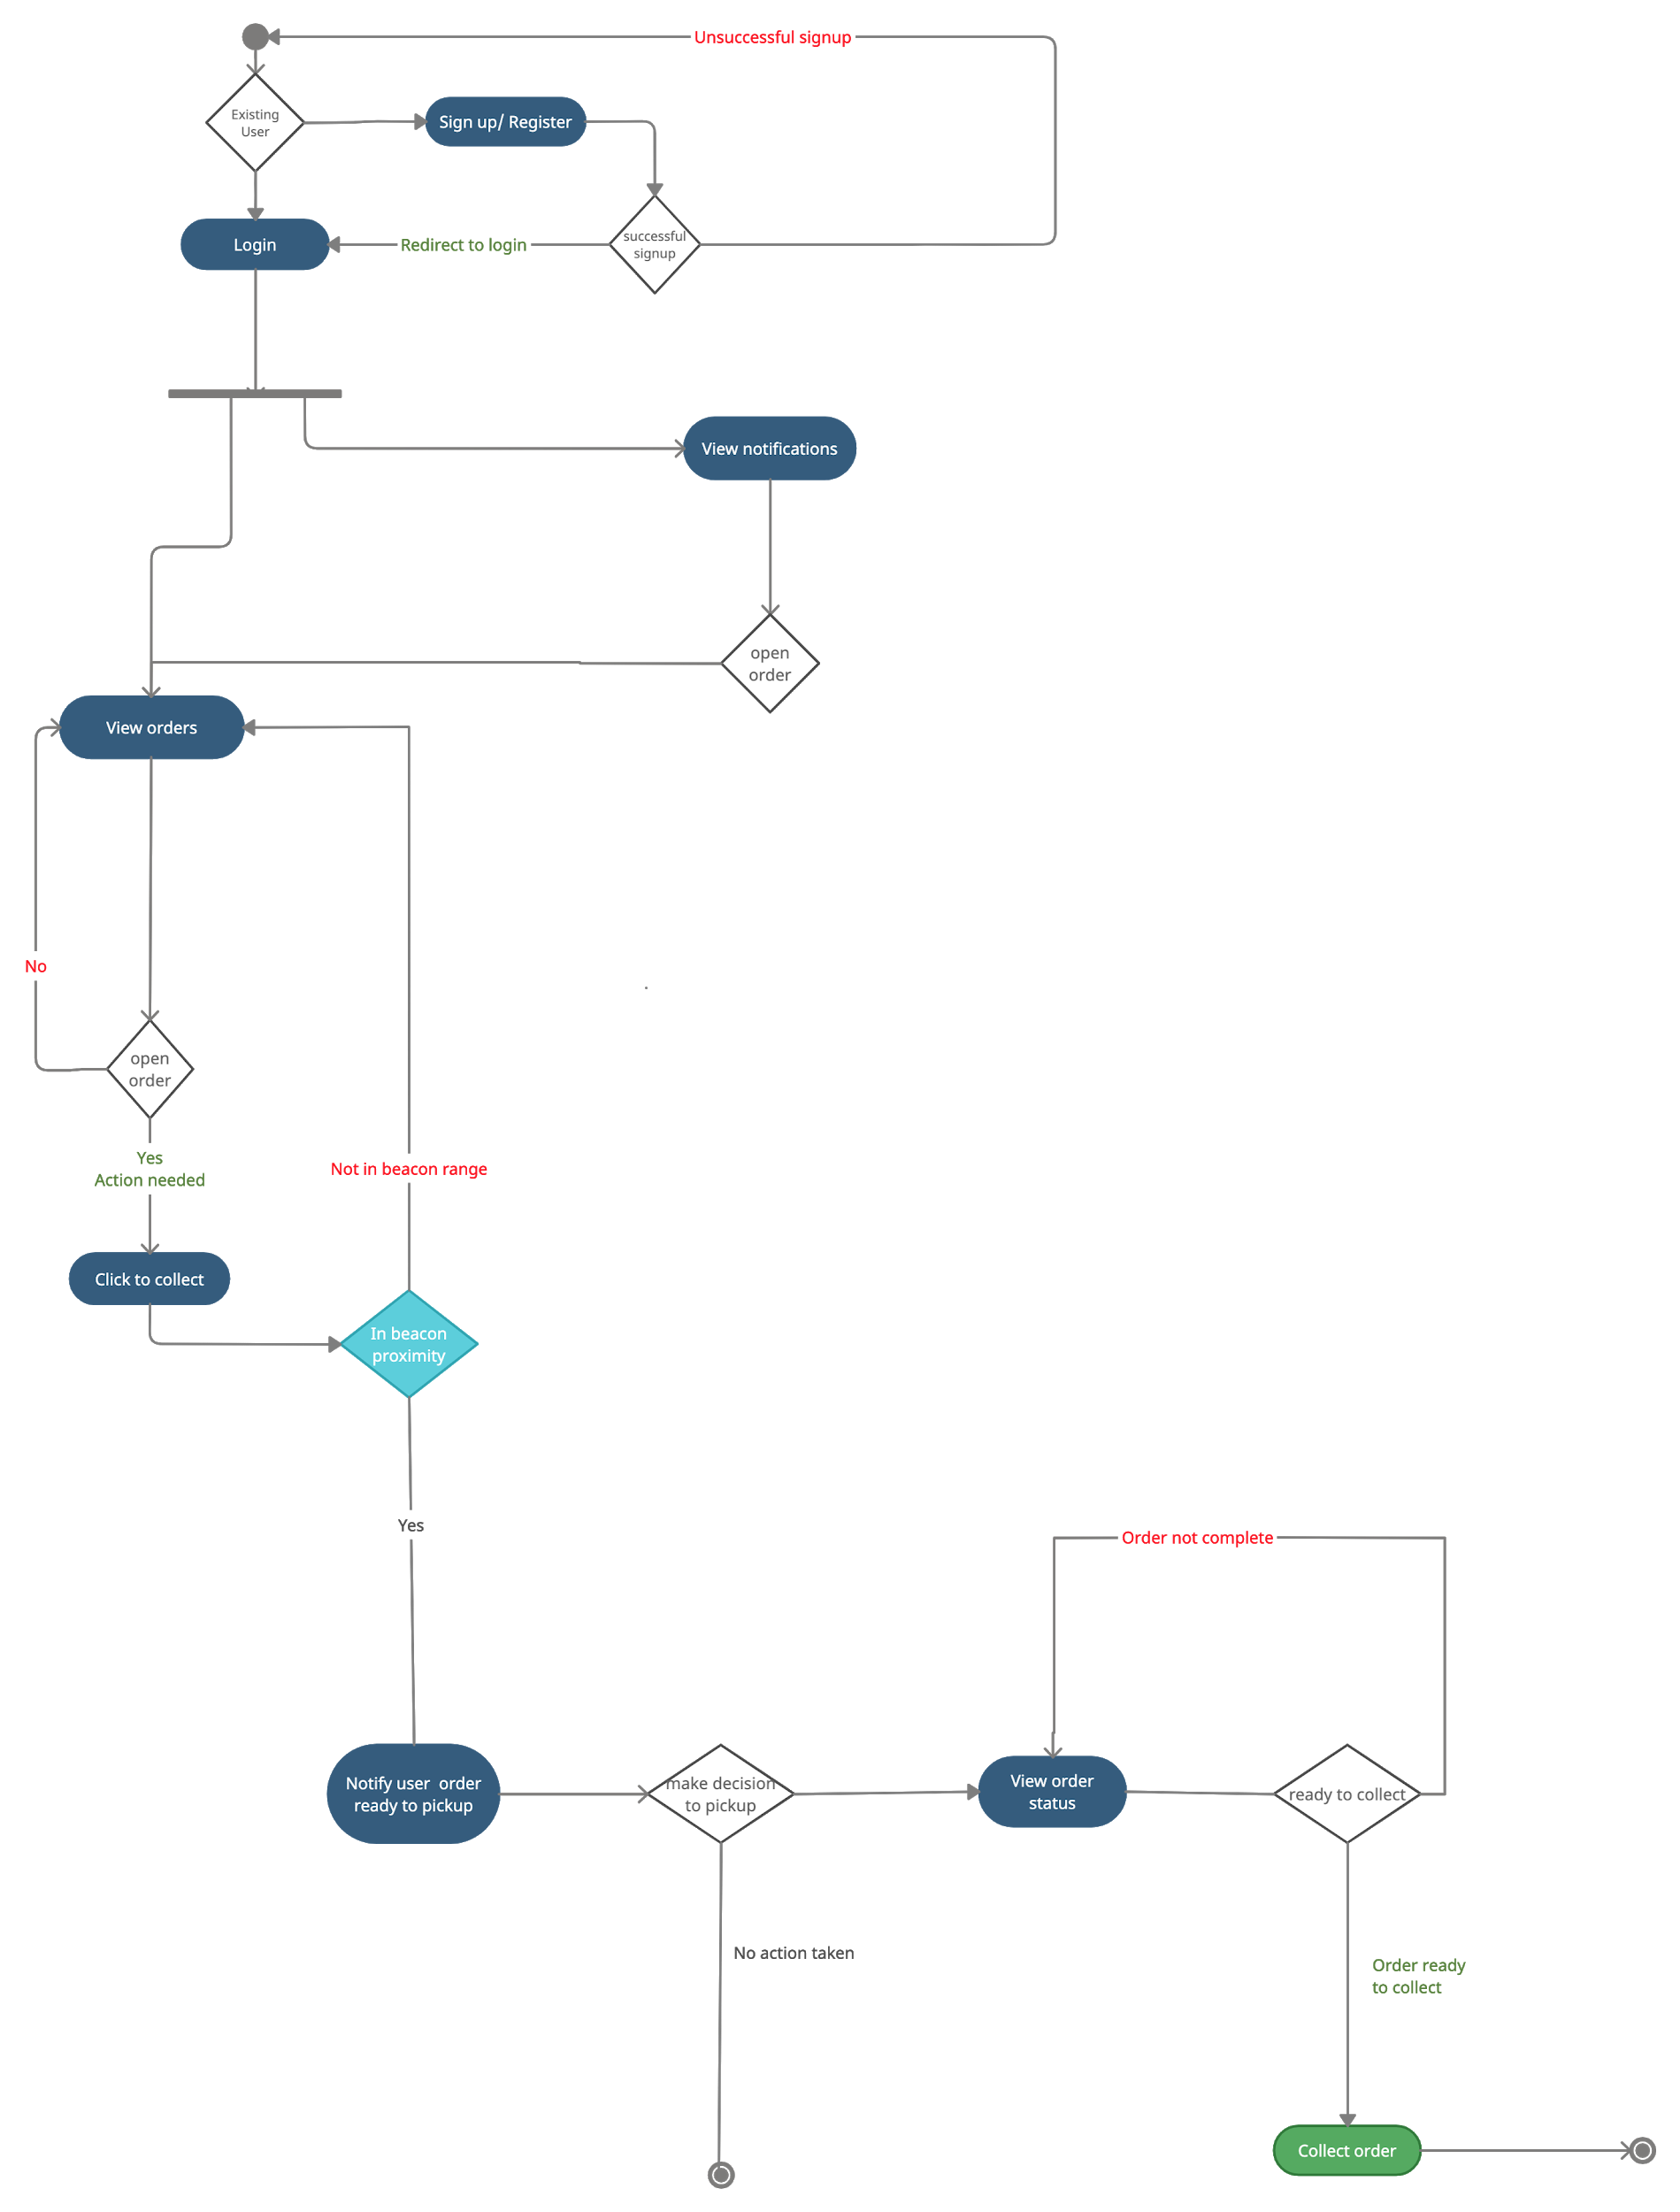
Activity Diagram

Slide 24
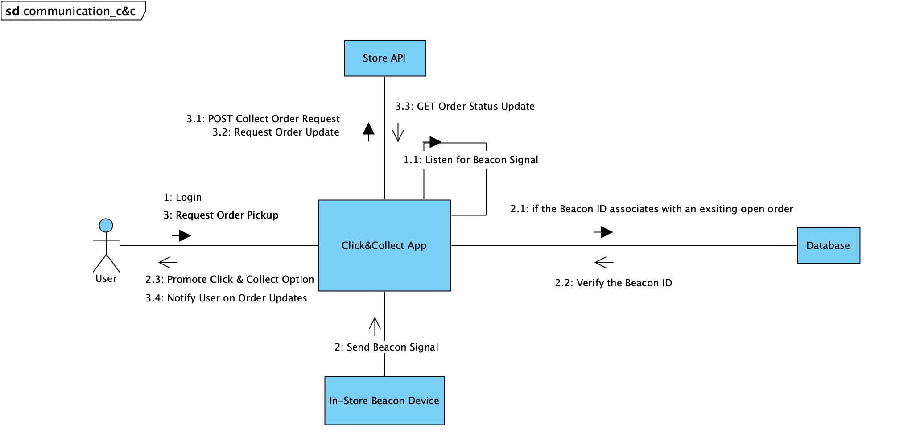
Collaboration Diagram

Slide 25
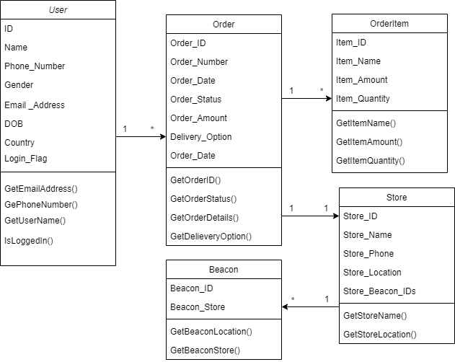
Class diagram

Slide 26
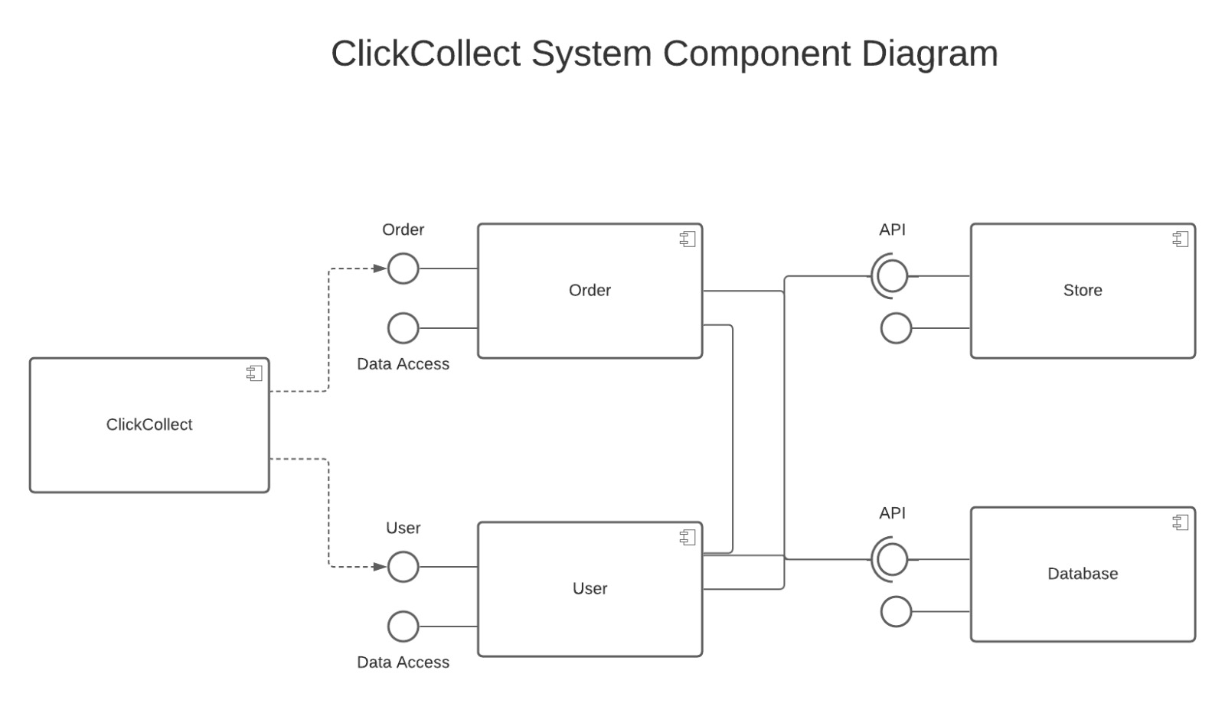
Component diagram

Slide 27
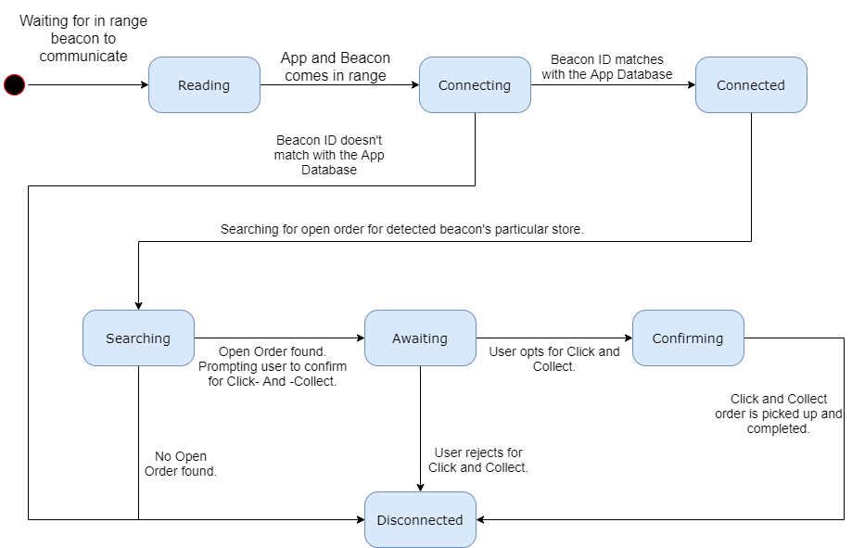
State diagram

Slide 28
System Design Overview
Components of the system:
iOS Application
Server Database
APIs
iBeacon devices
Modules of the system:
Login And Registration Module
Profile Module - Including Change Password,Edit profile details
Notification and action on notification module
View/Search/Filter Order module

Slide 29
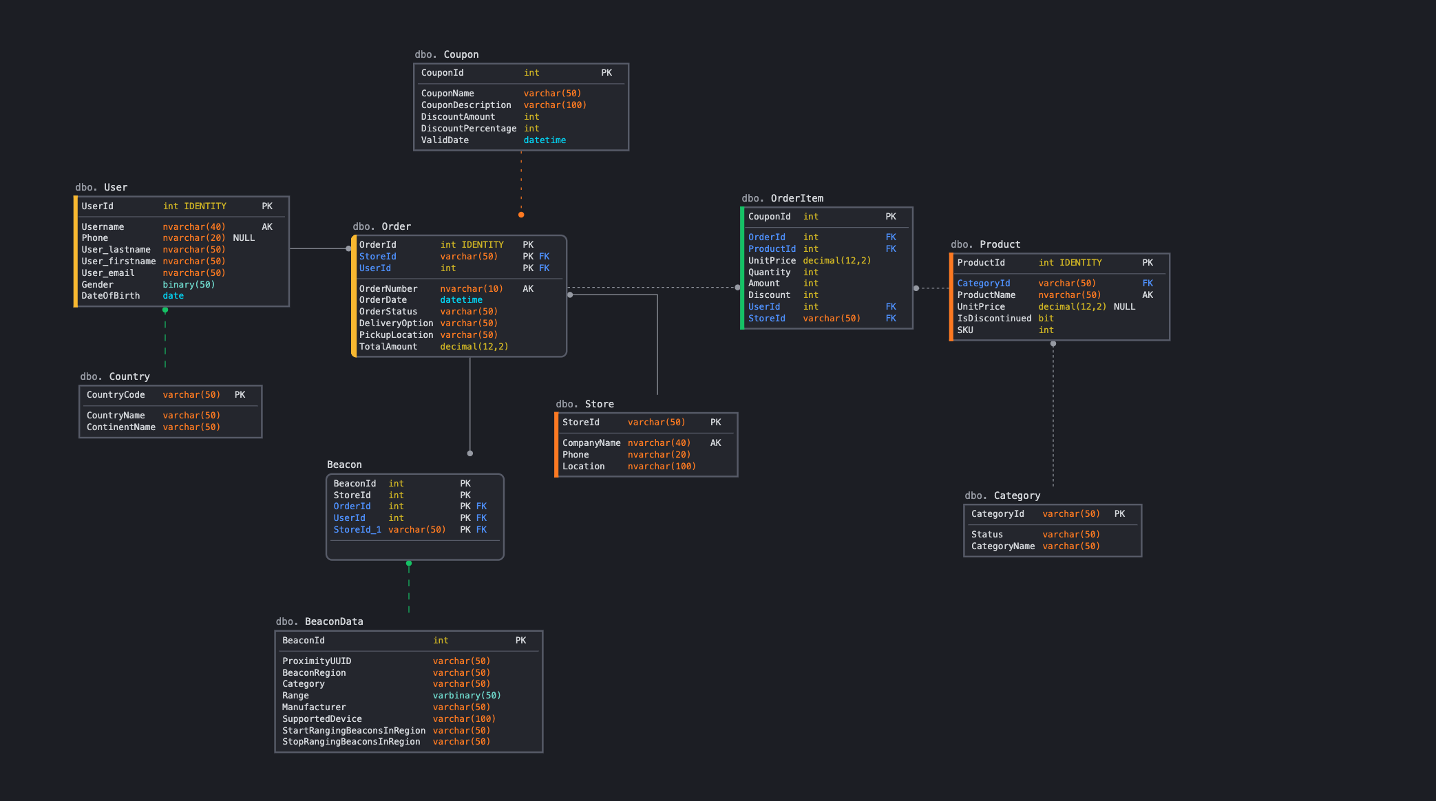
Database Architecture

Slide 30
Quality and Test cases
System Testing: test integrated hardware and software system to verify that the system meets its specified requirements.
Regression Testing: uncover software errors after changes to the program (e.g. bug fixes or new functionality) have been made
Performance Testing: ensure software applications will perform well under their expected workload.
Unit Testing: validate that each unit of the software code performs as expected
Integration Testing : individual units / components are combined and tested as a group. Expose faults in the interaction between integrated units. Test drivers and test stubs are used to assist in Integration Testing.

Slide 31
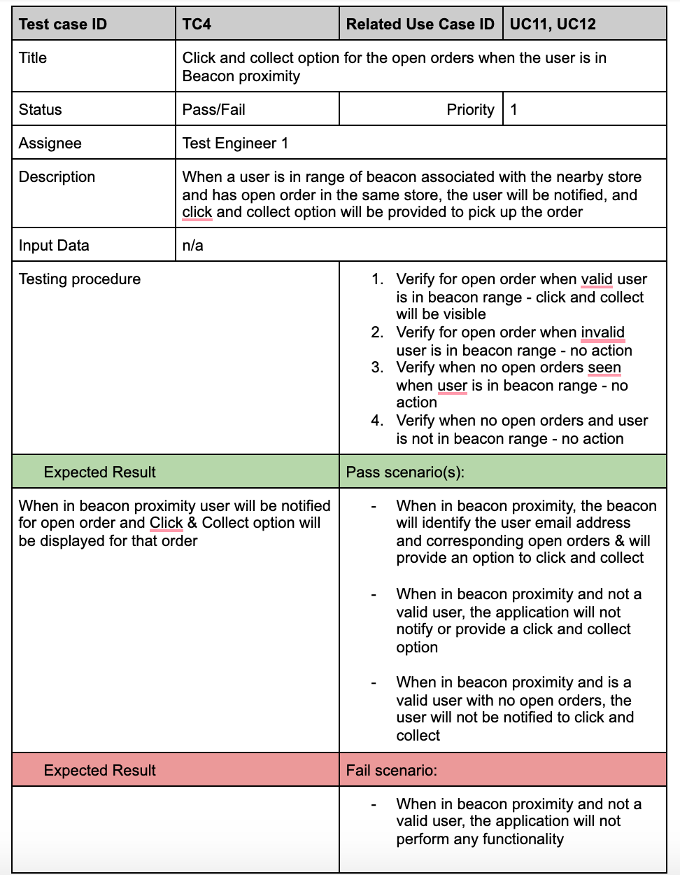
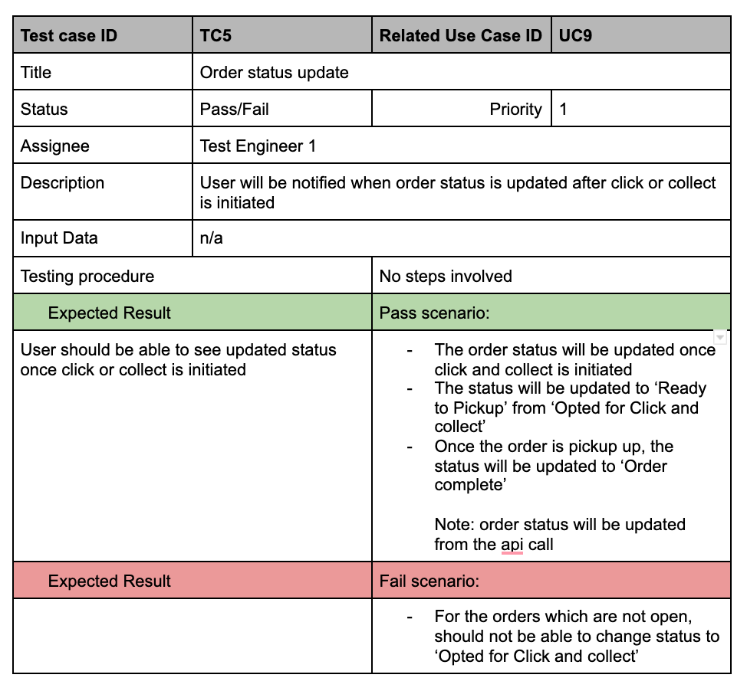
Test scenarios

Slide 32
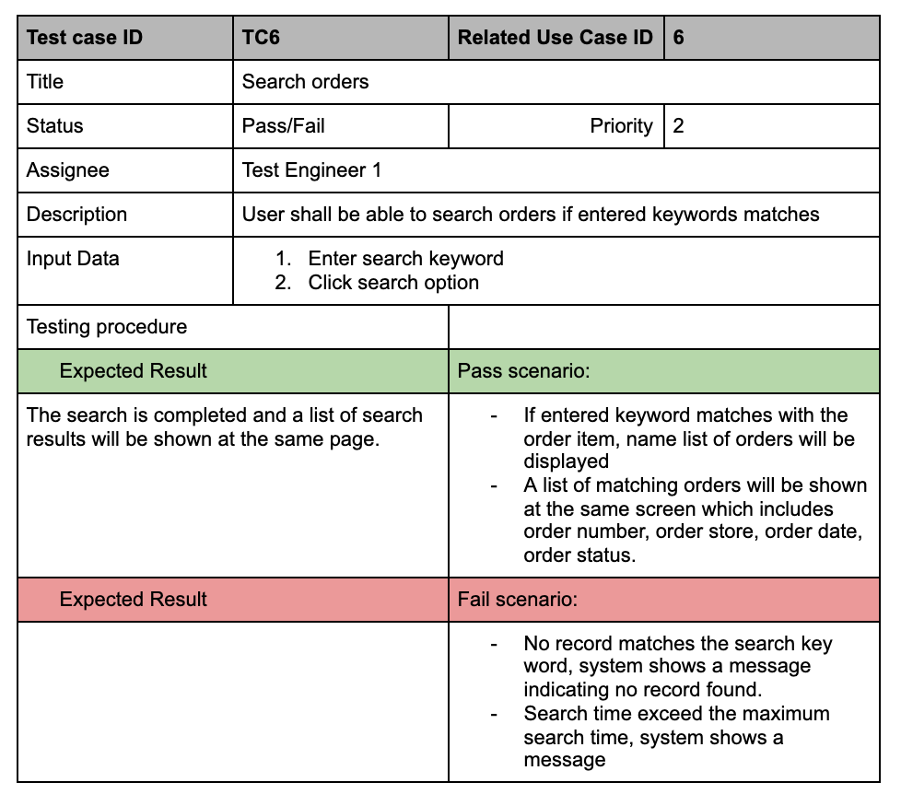
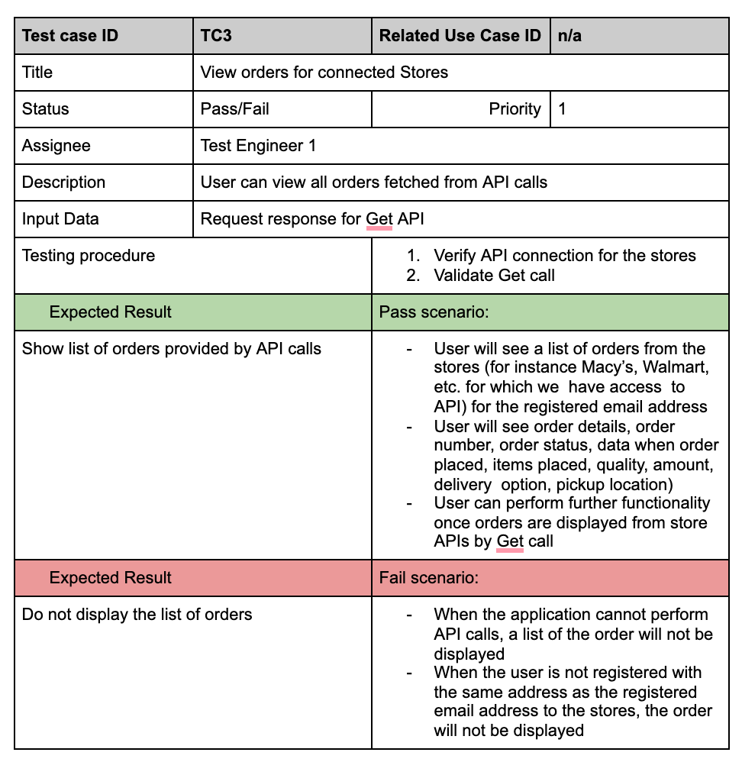
Test scenarios

Slide 33
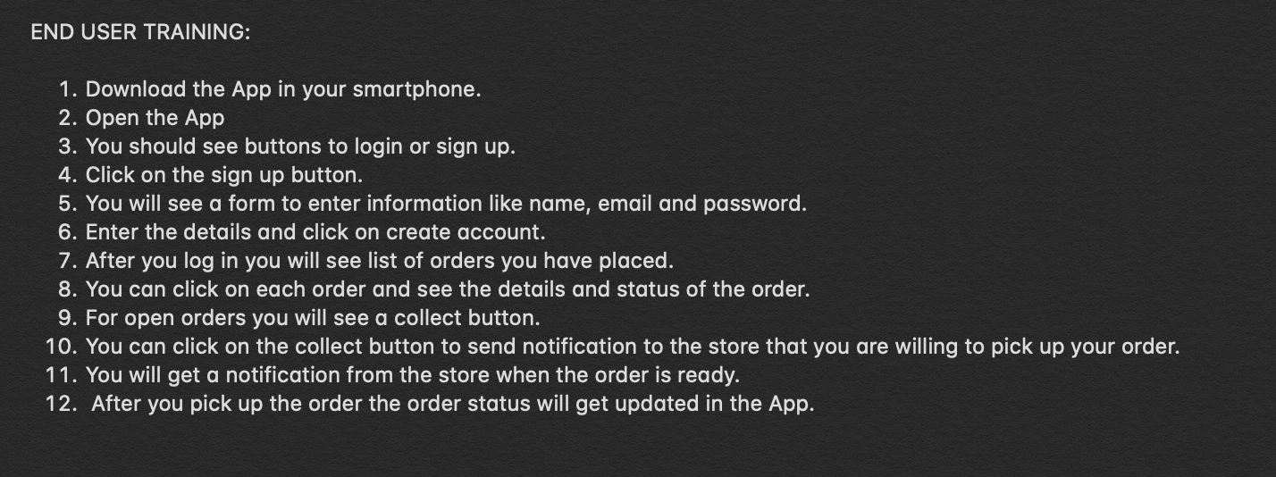
Training Plan

Slide 34
Resources
https://www.linkedin.com/pulse/using-beacons-better-in-store-customer-experience-greg-henry/
http://collectec.com/beacon-click-and-collect/
https://blog.beaconstac.com/2016/01/creating-a-beacon-campaign-for-your-supermarket-using-beaconstac/
https://www.appdynamics.com/blog/product/beacon-technology-everything-you-need-to-know-to-start-coding/
https://docs.gluonhq.com/samples/beacons/
https://reqexperts.com/wp-content/uploads/2015/07/writing_good_requirements.htm
https://www.researchgate.net/publication/284173600_Guidelines_for_Good_Requirements_Writing_with_Examples
https://clearbridgemobile.com/how-to-build-a-mobile-app-requirements-document/
https://www.javatpoint.com/software-engineering-software-reliability-metrics
https://developer.apple.com/ibeacon/

Slide 35
Report and Trello links
Trello : https://trello.com/invite/b/UIa5ng5A/629c112e5af82ec4cbca928efa6e14db/swe-600-group-project
Report Draft:
https://docs.google.com/document/d/1-xSw3HKgucqXhRE2tt3yHzdSYXrUB2WbNtxozkhzigw/edit?usp=sharing

Slide 36
Lessons Learned
First understand the requirements
Teamwork
Leadership experience
Risk analysis
UML Diagrams
The non-technical problems are the most difficult
What you create is more important than the tools used to create it
Every role is equally important
Never Assume
Start Small
Have an Estimated Project Length? Double it.
Understand the Code Before Changing It
Develop an Error Handling Landscape
Bugs are Unavoidable
Seek Help When You Can’t Cope on Your Own
Keep on Learning

Slide 37
Q&A?
Thank you!

